Slide 1
Relevant Field Investigations
The Intersection of Place and Problem

Slide 2
The Ultimate Challenge for a Teacher
“We have come to realize that meaning matters and is not something that can be imparted from teacher to student. In a sense, all teachers can do is to ‘make noise in their environment.’ We have no main line into the brains of our students. We are shapers of the environment. But in the end, what children make of what we provide is a function of what they construe from what we offer. Meanings are not given, they are made.”
~ Elliot Eisner (1999, p. 658)

Slide 3
Place and Space
The National Geography Standards (1994) defines space in terms of location, distance, direction, pattern, shape and arrangement and place as the relationship between physical environmental characteristics (e.g., climate, topography, vegetation) and human characteristics (e.g., economic activity, settlement, land use).
Place is space endowed with physical and human meaning.

Slide 4
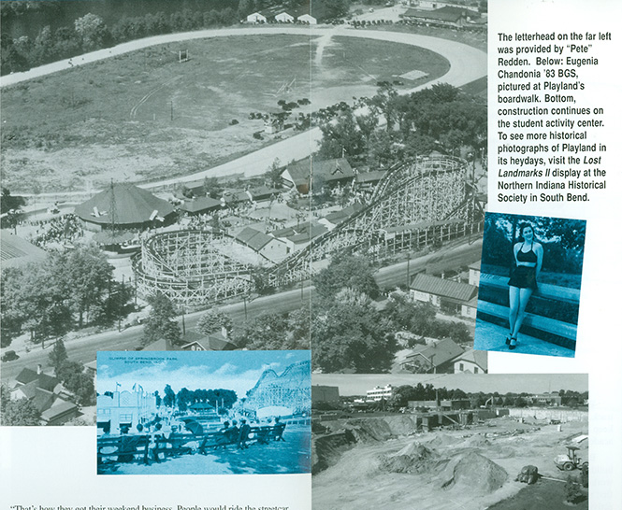
The Restored Wetlands

Slide 5
The Restored Wetlands
Spatial Perspective | Ecological Perspective | Economic Perspective | Historical Perspective
What features, patterns, and relationships do you see? | What connections to and impacts on the environment are present? | How might the economics affect its’ features or characteristics? | How has this location changed over time?
Describe the physical or natural characteristics of IUSB’s Restored Wetlands (e.g., landforms, soil types, water features, etc.).
Describe its’ human or cultural characteristics (e.g., population, land use, economy, etc.).

Slide 6
Local Learning by Asking Local Questions
What defines the Restored Wetlands?
Describe its parts and the interrelationships found there?
What is my relationship to this place?

Slide 7
Diversity of Field Investigations
Descriptive Field Investigations | Comparative Field Investigations | Correlative Field Investigations
Describing and/or quantifying parts of the natural system | Collecting data on different populations/organisms, or under different conditions (e.g., times of year, locations), to make a comparison | Measuring or observing two variables and searching for a relationship

Slide 8
Steps of Field Investigations
Developing the questions
Isolating the question
Describing the site
Designing the study
Collecting data
Communicating the findings

Slide 9
Steps of Field Investigations
Developing the questions
Spend time observing the place
Journal all questions that come to mind but retrain your mind to only ask “why” and “how” questions

Slide 10
Steps of Field Investigations
Isolating the Question
Share your questions
Select the “one” to carry further

Slide 11
Steps of Field Investigations
Describing the Site
Return to the original site for further observations (e.g., drawing, using numbers, labeled diagrams, writing)
What does “it” look like? (e.g., size, shape, color)
What does “it” feel like? (e.g., texture, temperature)
What does “it” smell like?
What does “it” sound like?

Slide 12
Steps of Field Investigations
Designing the Study
Review the question
Journal multiple hypotheses
Write predictions for each hypothesis
Identify materials needed for the investigation

Slide 13
Connecting the Experience
How might this work for you and your students?
What other learning opportunities may emerge out of a similar experience?

Slide 14
Conclusion
Once a teacher makes the connection between the classroom world and the world outside, enormous possibilities open like a morning glory bud untwisting at dawn, a beautiful unfurling of inspiration and wonderment.
~ Zwinger, 1996, p. vi

Slide 15
Resources
Field Investigations: Using Outdoor Environments to Foster Student Learning of Scientific Processes http://209.15.226.145/~fishwild/corecode/uploads/document/uploaded_pdfs/corecode_fishwild/ConEd-Field-Investigations-Guide_13.pdf
Schoolyard Biodiversity Investigation Educator Guide http://www.fishwildlife.org/files/ConEd-Schoolyard-Biodiversity-Guide.pdf
Landscape Investigation Guidelines http://www.fishwildlife.org/files/ConEd-Landscape-Investigation-Guidelines.pdf

